Slide 1
SMART RESERVATION & OPTIMIZATION PLATFORM
Prepared by: Brian Mwalish
ID: SANYBR2211
supervisor: Mr. FRED MOBISA

Slide 2
Problem statement:
No-shows and last-minute cancellations are persistent issues for restaurants, leading to wasted seating capacity, lost revenue and disruptions in restaurant operations. This is particularly problematic during peak times or special events when the restaurant could have sold the table to another customer.

Slide 3
Proposed System
Smart reservation & optimization platform is a comprehensive reservation management system that focuses on mitigating the financial and operational impact of no-shows and cancellations. By using the digitized reminders, implementing a flexible penalty dashboard, and offering loyalty rewards, this system ensures that the customers stay committed to their bookings. It also optimizes table availability

Slide 4
Objectives
To develop a system that minimizes the financial and operational impacts caused by no-shows and last-minute cancellations.
2. To develop a system that boost customer commitment by integrating loyalty rewards and punctuality incentives, transforming cancellations into opportunities for repeat patronage.
3. To develop a system that streamline restaurant operations with real-time table allocation and, enabling efficient reallocation of cancelled reservations to optimize seating capacity

Slide 5
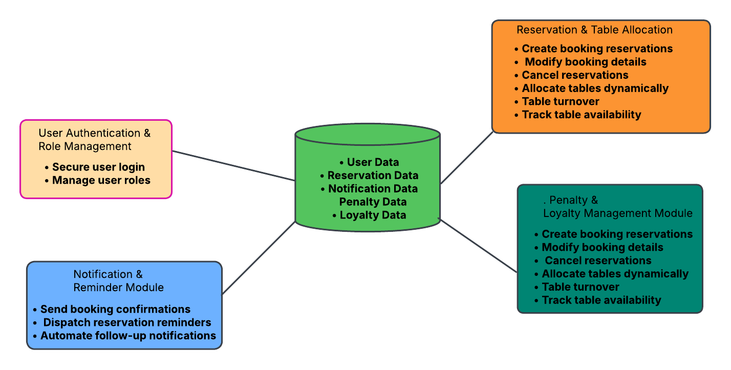

Slide 6
Technical Requirements:
Frontend: React.js for a responsive, dynamic user interface.
Backend: Spring Boot for business logic and API handling.
Database: PostgreSQL to store reservations, users, and loyalty data.
APIs: RESTful APIs enable frontend-backend communication.
Integrations: Twilio/SendGrid for notifications, Stripe/PayPal for payments.
Hosting: Cloud-based (AWS) for scalability and reliability.

